Slide 1
Mathematics For Computing Digraphs and Relations
www.Stats-Lab.com

Slide 2
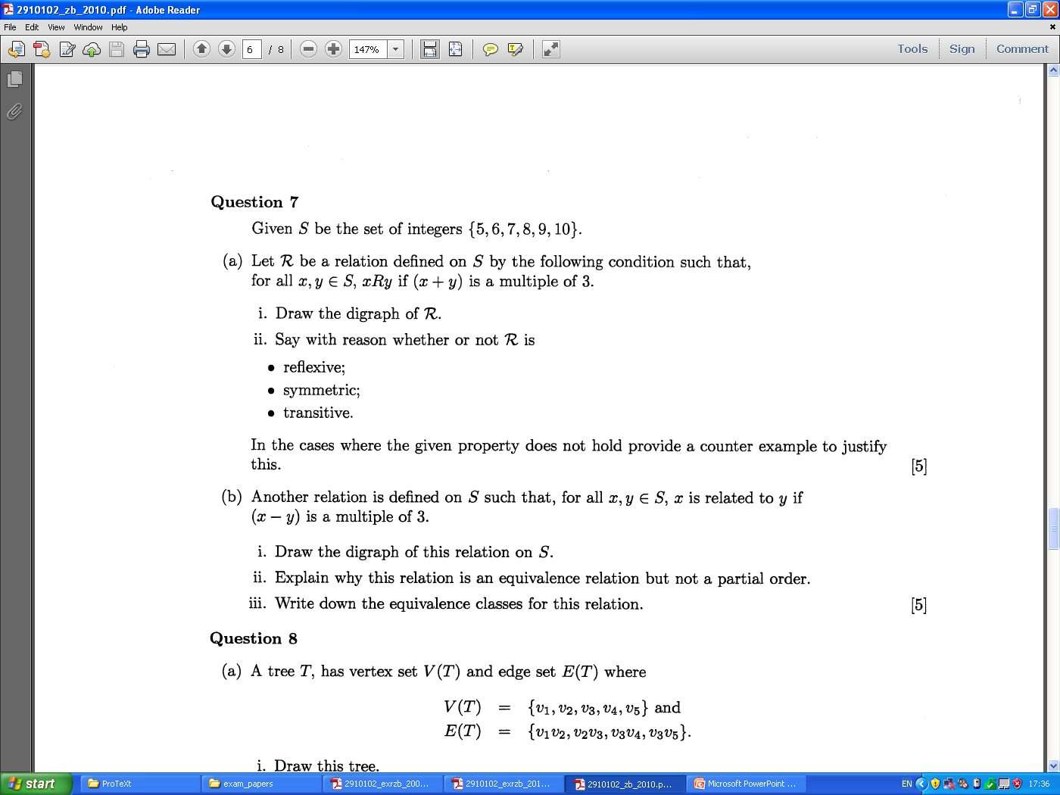
Digraphs and Relations

Slide 3
Digraphs and Relations

Slide 4
Digraphs and Relations

